Slide 1
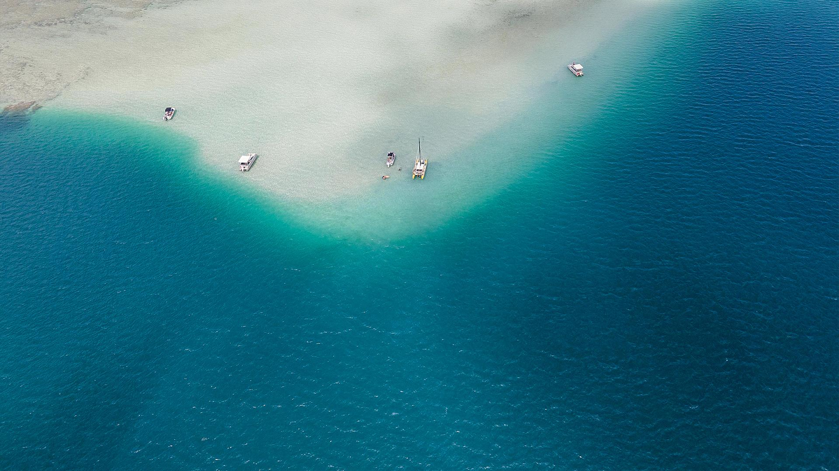

SHARK TALE
Presented by The Golden Dragon Triad
Xiaobo, Kranta, Martino & Stéphanie
Notes:
Stéphanie

Slide 2
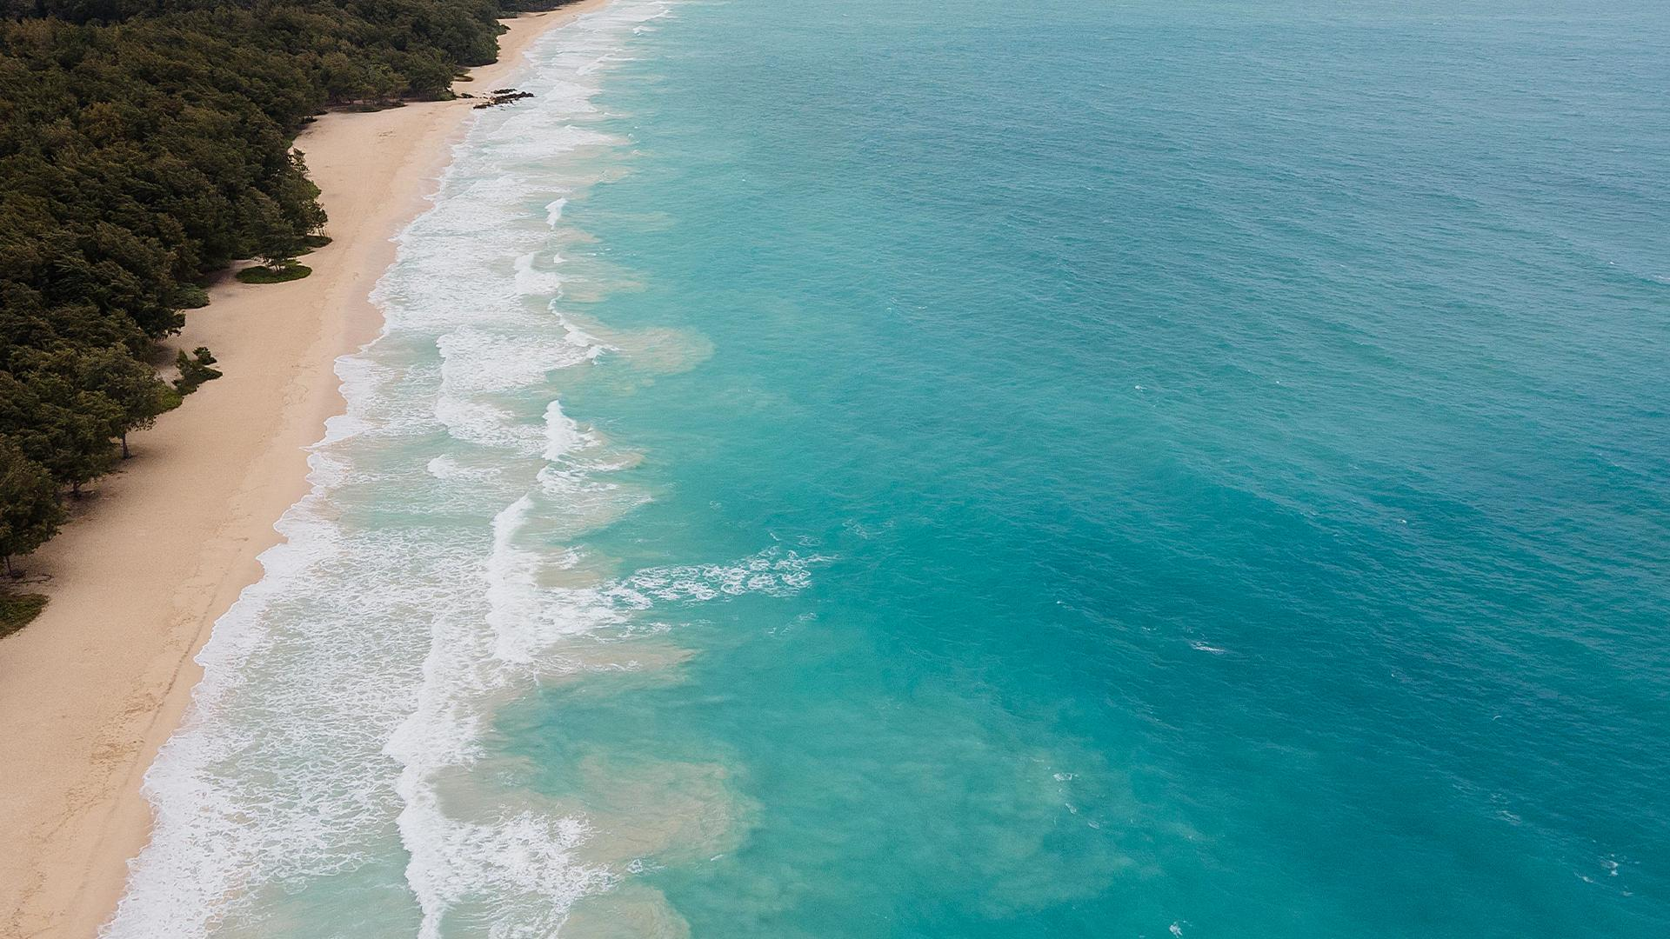
ABOUT US
Providing Sharks for any type of use
Notes:
Stéphanie

Slide 3
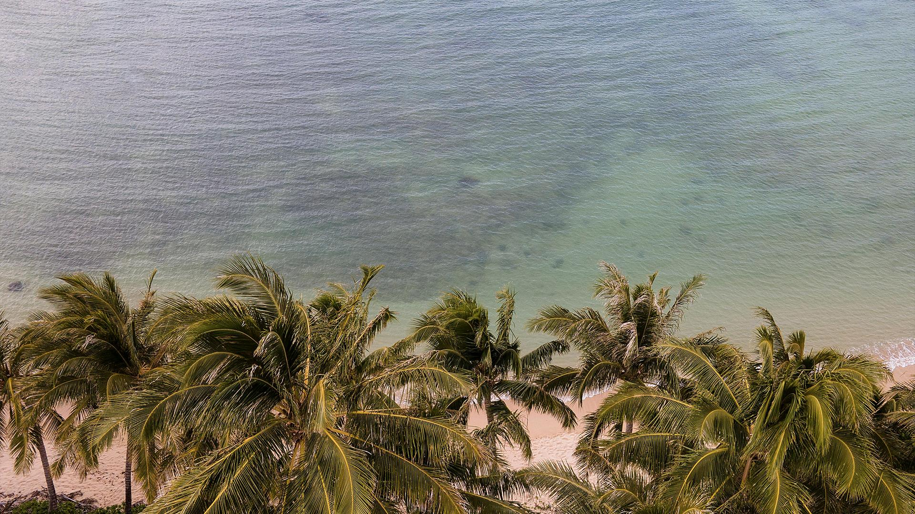
WE PROVIDE THE SHARKS FOR YOU
SERVICES :
A shark as Pet
A shark as Meal
A shark to kill
HIGH STANDARD UNDERWORLD CLIENTS :
Mafia
Cult
Pedophile Network
High profile
FISHING AREA :
Australia
US
South Africa
CONFIDENTIALITY & SECURITY :
Only on the darkweb
Payment in bitcoins
Contact in telegram
‘2
Notes:
Stéphanie

Slide 4

LET’S DIVE INTO THE UNDERSEA !
‘2
Notes:
Stéphanie

Slide 5
Groups and Locations Prone to SHARKS
AGE
LOCATION
-12
8.1%
12-18
11.0%
18-60
76.4%
60+
4.5%
Notes:
Kranta

Slide 6
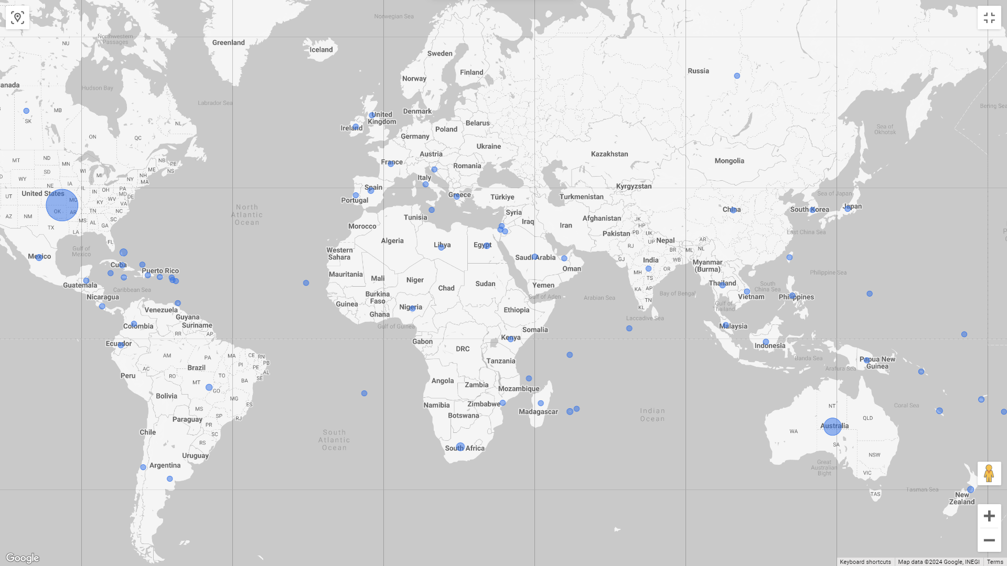
Map of Shark Activity
Notes:
Kranta

Slide 7

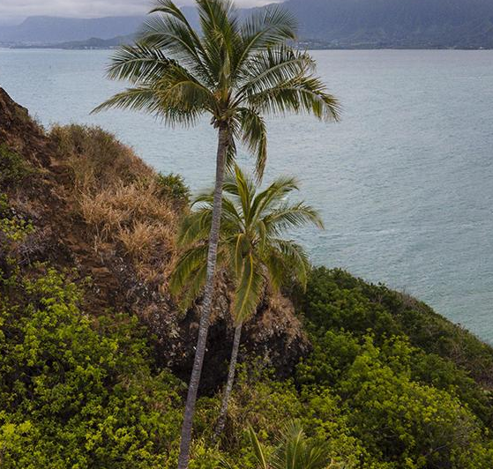
PROJECT OVERVIEW :
Cleaning & data manipulation :
isnull, dropna(), fillna(), value_counts(), replace()
Combining & structuring data :
join(), median(), concat(),
Aggregation data :
median(), groupby() .loc (?)
Visualisation :
matplotlib.pyplot
lookerstudio.google.com
Function/module imported :
Dataprep() -> clean country, Pandas, Numpy, pd.set_option(), re,
Function created :
check_season(), set_time_group(), fix_age(), fix_time,
format_date, filter_year(), Unknown_age(), set_age_group()
Notes:
Kranta

Slide 8
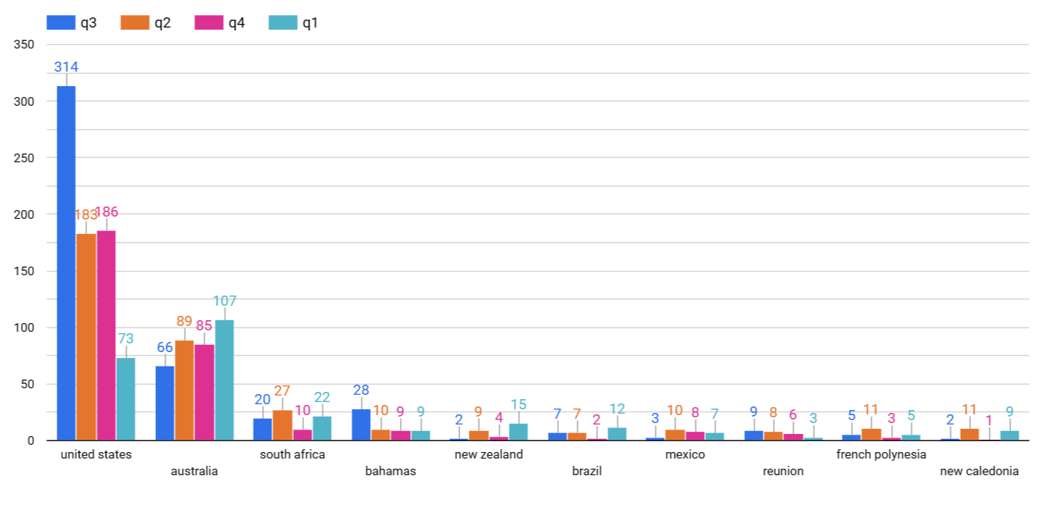
Shark Attacks in Each Country (>20) from 2010
Notes:
Kranta

Slide 9
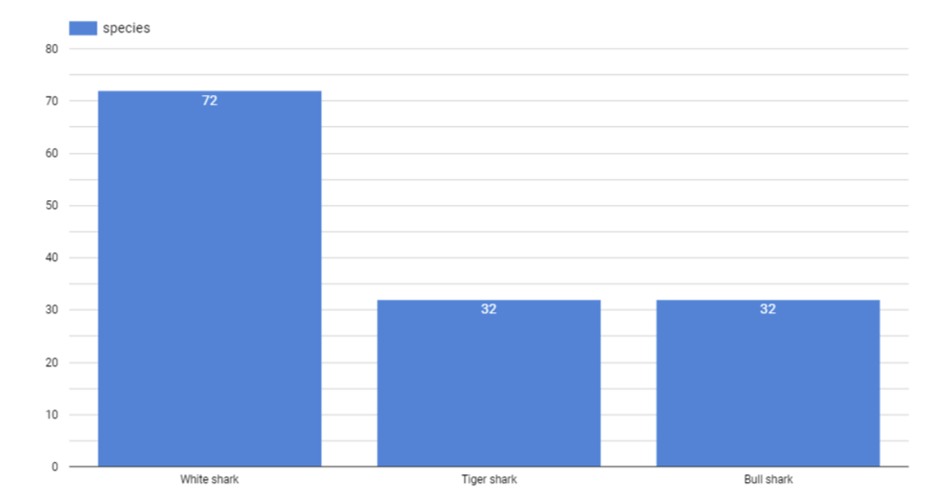
Top 3 Species of Shark
Notes:
Xiaobo

Slide 10
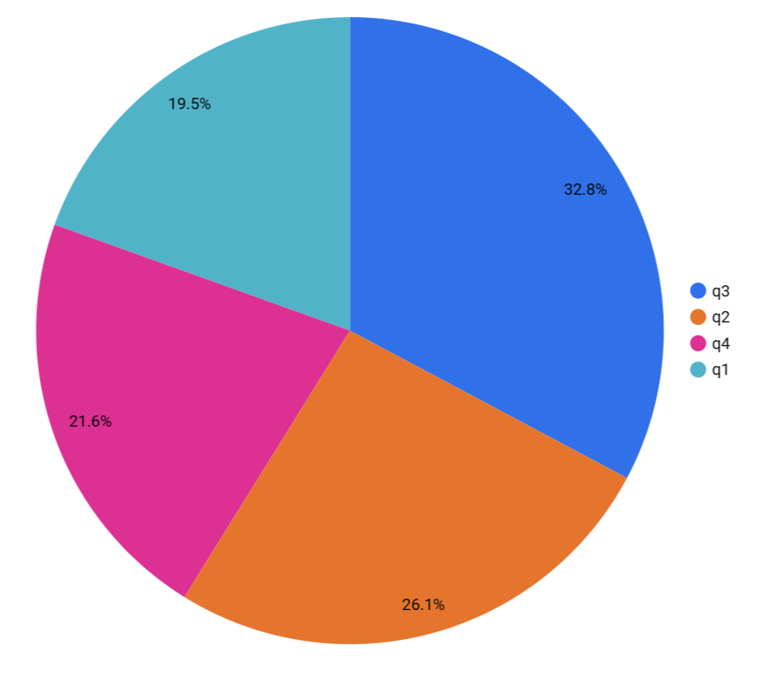
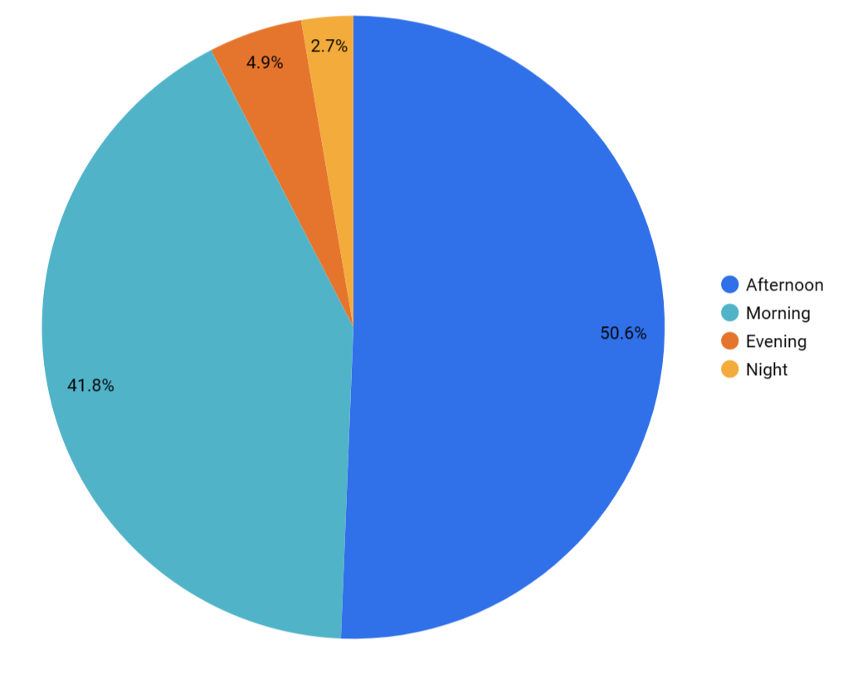
Shark Attacks in Each Quarter
&
Shark Activity time
Notes:
Xiaobo

Slide 11
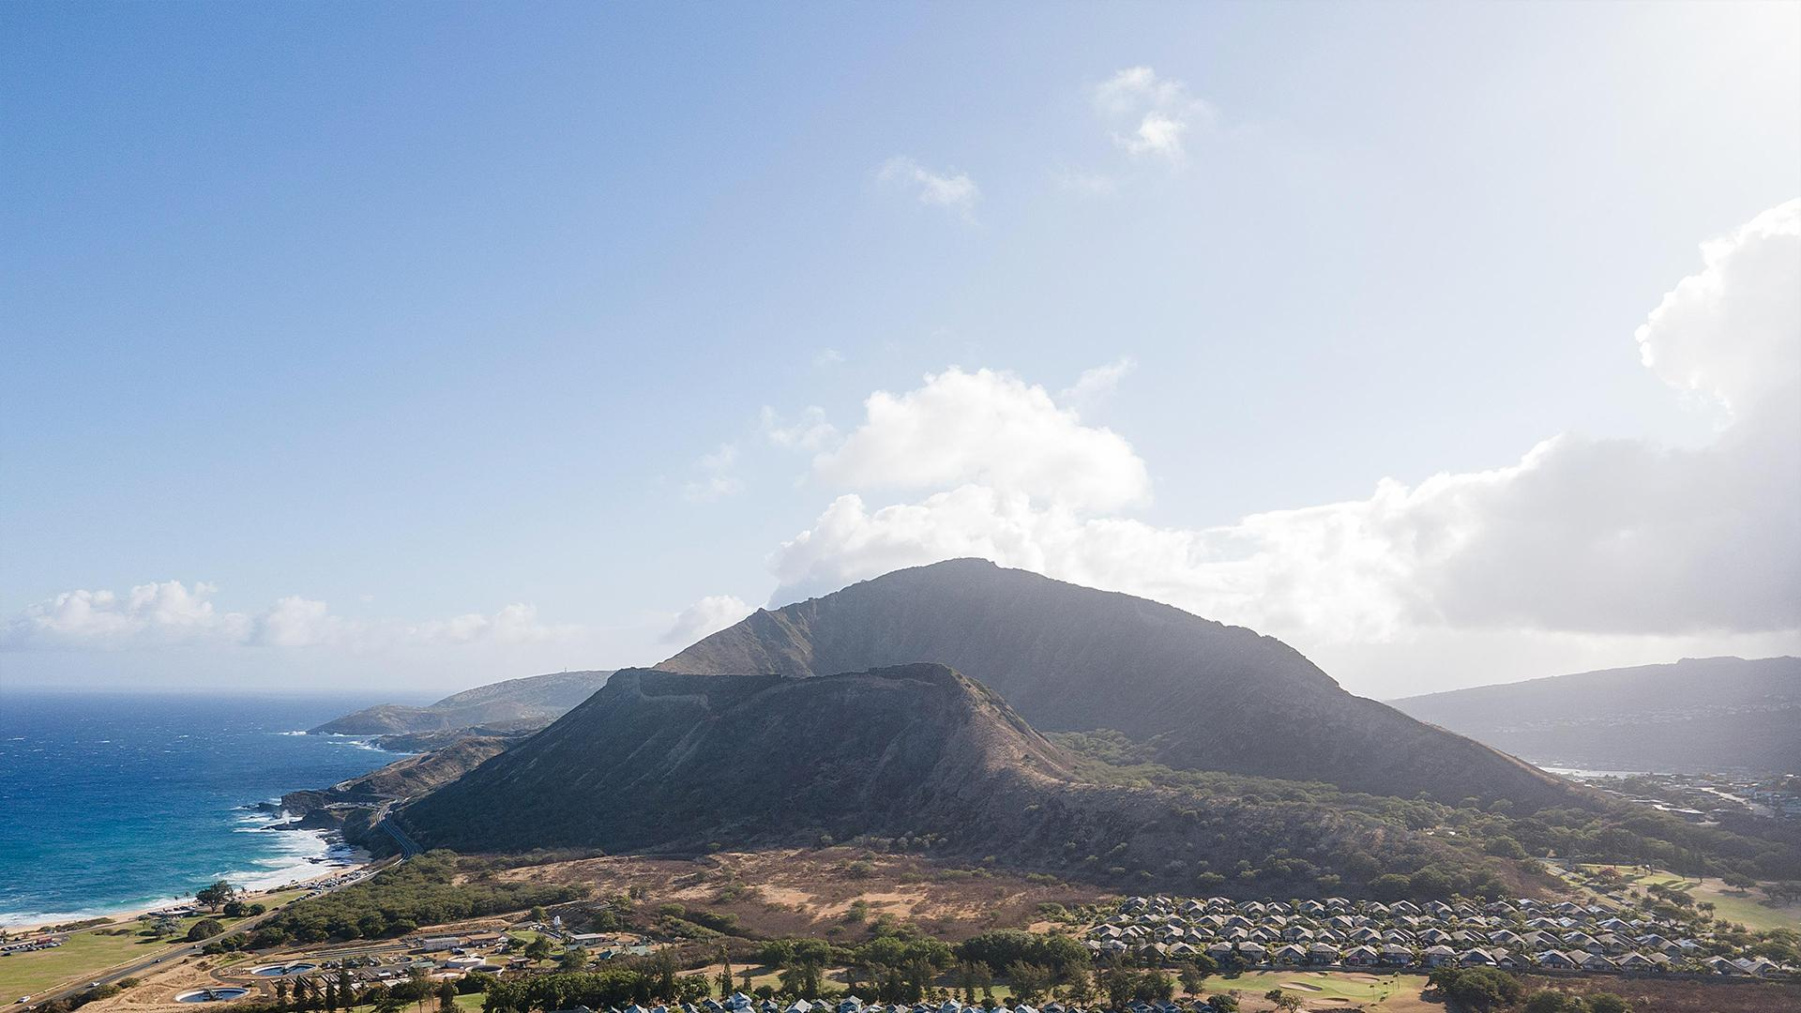
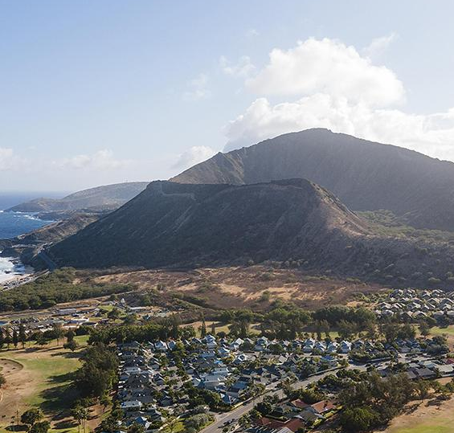
Technical challenge :
Cleaning the data
Format the columns time/date/age/country
Function not support in different version of python
Figuring out how to code at the same time
Notes:
All together

Slide 12
MAIN CHALLENGES
Brainstorming
Divide the work
Sort out the data
Time
Included after 2010

Slide 13
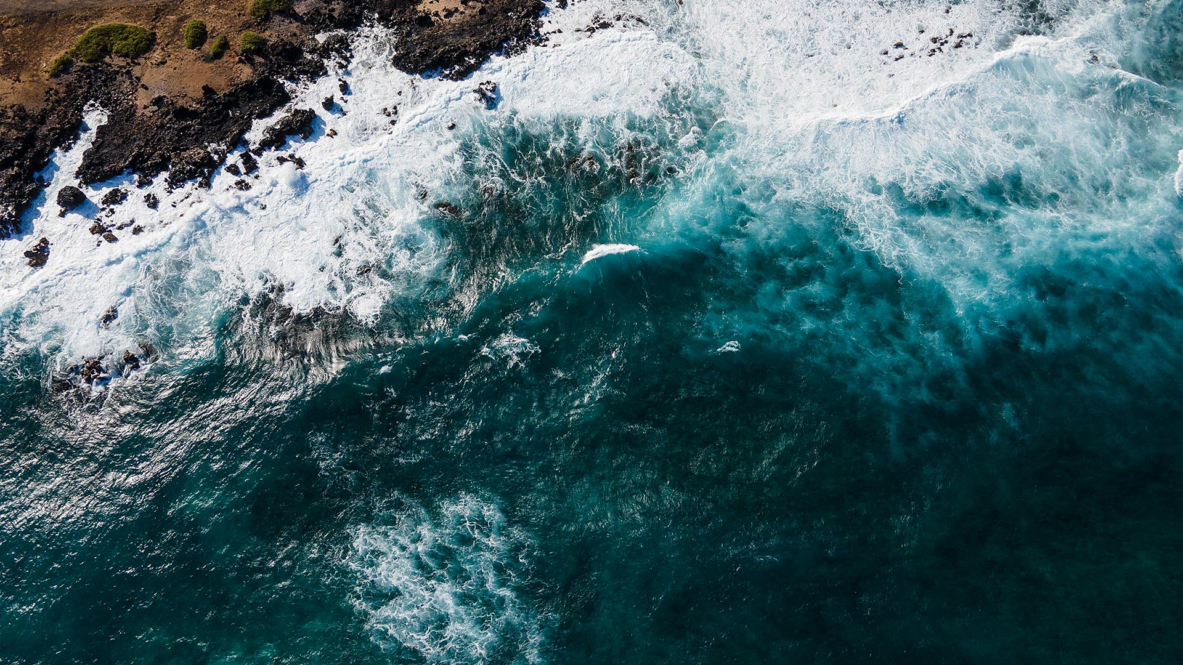
GOOD PRACTICES
Good & Efficient debugging
team work
Having Fun

Slide 14
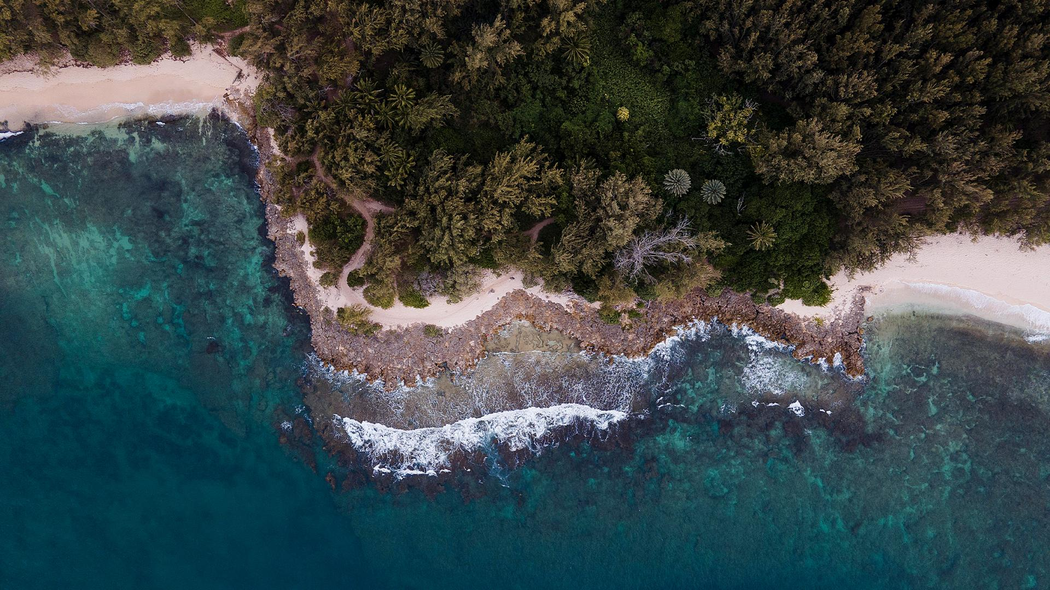
NEXT STEPS
Cleaner Data in species
Mixing the age and the localisation filter
Expand business
Presenting a catalog
Developing the network

Slide 15


THANKS!
DO YOU HAVE ANY QUESTIONS?
Contact@sharktale.com
+91 620 421 838
sharktale.com
Notes:
Stéphanie

